Slide 1

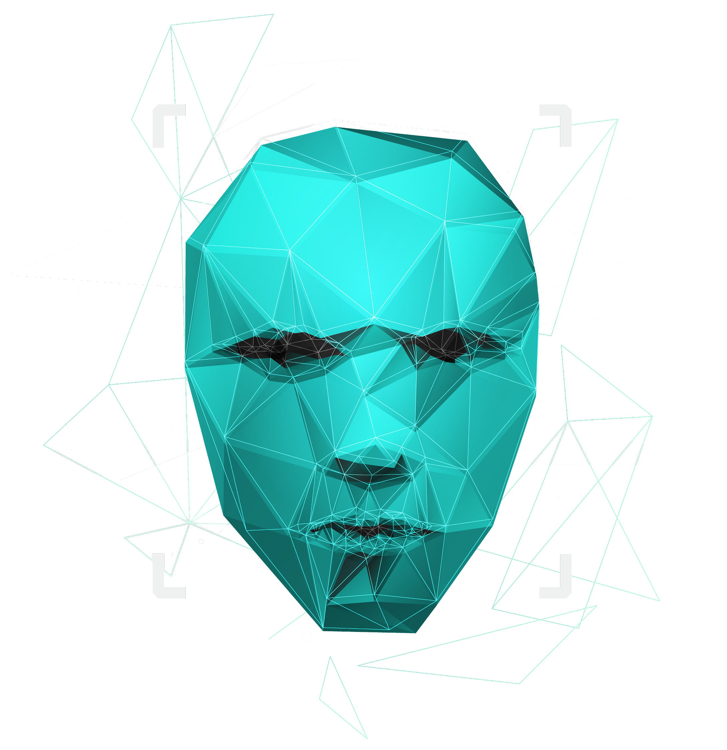
AUTO INSURANCE FRAUD DETECTION
Capstone Project
Dec 07, 2022
Suganya AM

Slide 2
TABLE OF CONTENTS
1
2
MOTIVATION
INTRODUCTION
3
4
COMPONENTS
BACKGROUND
5
MODEL ARCHITETCURE
6
HYPER PARAMETER TUNING
8
MODEL DEPLOYMENT
7
RESULTS

Slide 3
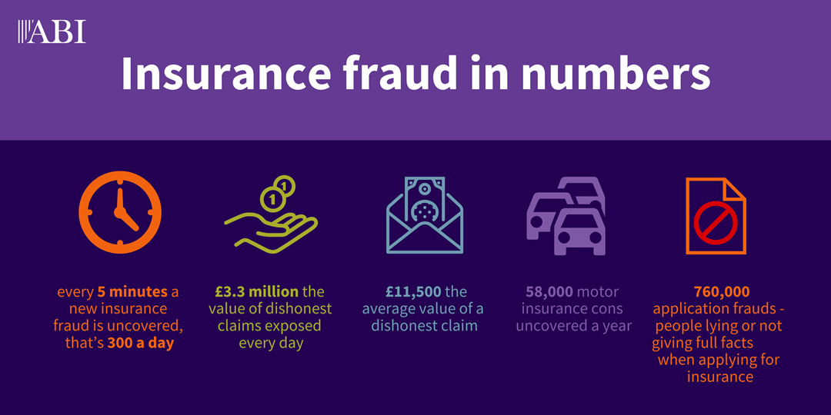
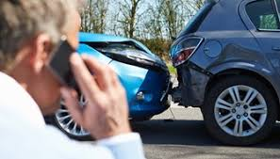
Why Auto-Insurance Fraud?
Auto Insurance Fraud is the largest area of insurance fraud.

Slide 4



Insights into Financial Impacts
The Insurance Bureau of Canada estimates that insurance fraud costs in Ontario range between $770 million and $1.6 billion a year.
In 2021, SIU (special investigation unit) in SGI busted hundreds of people attempting to make fraudulent claims, saving the company around $6 million.
The Manitoba public insurer says investigations into nearly 1,000 suspicious claims resulted in more than $13 million in savings as of the end of November, up nearly $3 million from what investigators were able to save by the same time last year.

Slide 5
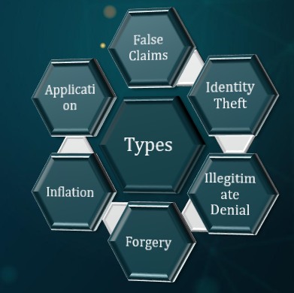

What is Fraud?
Wrongful or criminal deception intended to result in financial or personal gain.
An estimated 10% of claims filed with the insurance industry are fraudulent.

Slide 6

Problem Statement
The purpose of this project is to develop an AI Application by building predictive models to create a framework for fraud detection in the auto insurance industry.
Insurance fraud detection is a challenging problem due to the variety of fraud patterns and the relatively low ratio of known frauds in typical datasets.
The cost of false alarms needs to be balanced against the savings from loss prevention.

Slide 7
Background
Dataset: Kaggle; Type: Supervised Classification
Algorithms: SVC, KNN, Decision Tree, Random Forest, XG Boost, Extra Trees, Stochastic Gradient Boosting, Cat Boosting
Normalization: Standard Scaler; Encoder: Label Encoder, Custom Mapper
Technique: Voting Classifier; Hyper Parameter Tuning - CV
Evaluation Metrics: Accuracy, Recall, Precision, Accuracy
Outcome: This model enables the insurance company to accurately identify fraudulent claims, potentially lowering costs and increasing profitability.

Slide 8
Model Architecture
Data cleansing
Data Understanding
Data Ingestion
Data Pre-Processing
Data Exploration
Model Evaluation
Model Training
Data Processing
Label Encoding
Data Segregation
Data Scaling
Hyper Parameter Tuning
Build Data Pipeline
Save Model
Load Model
Model Deployment & Web Scripting

Slide 9
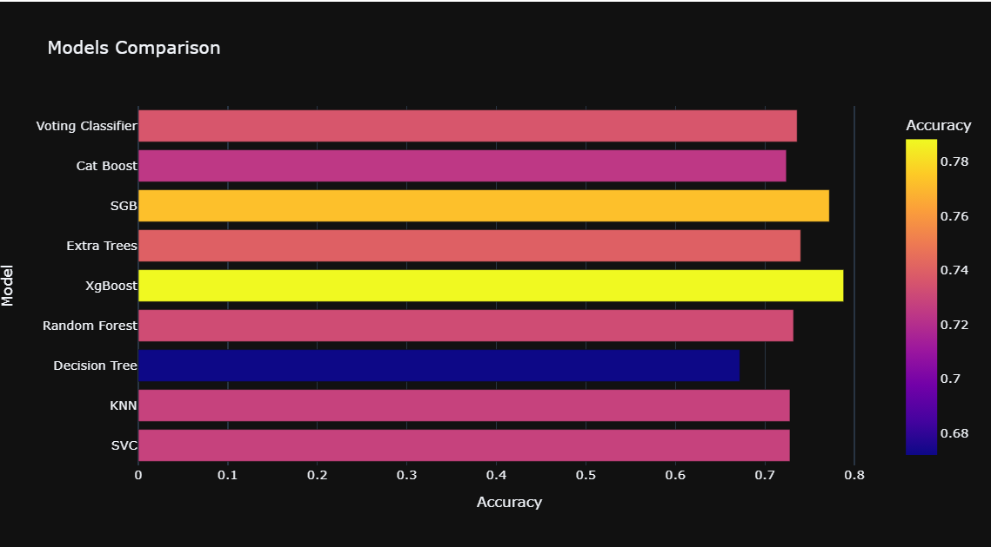
Results – Accuracy

Slide 10
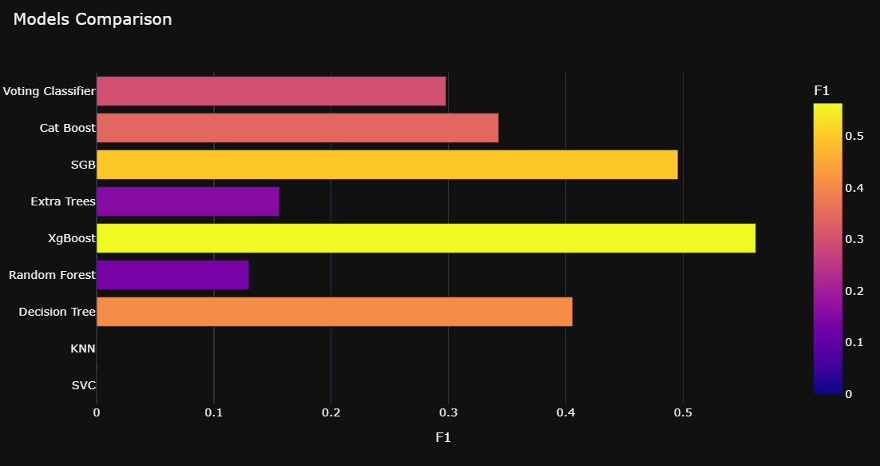
Results – F1

Slide 11
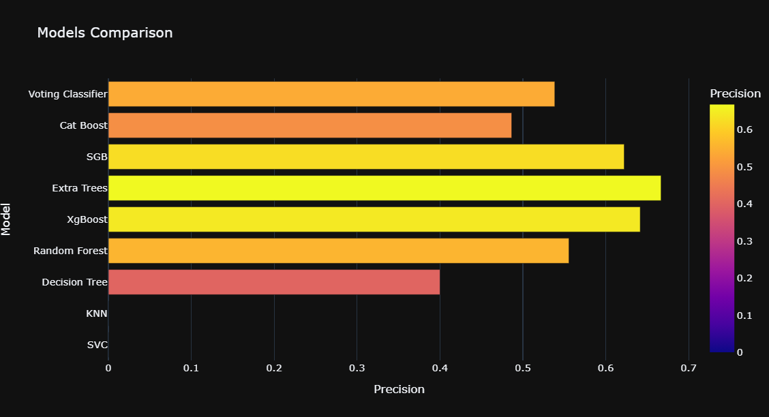
Results – Precision
Among all positive, how many of them were actually positive.
TP/TP+FP

Slide 12
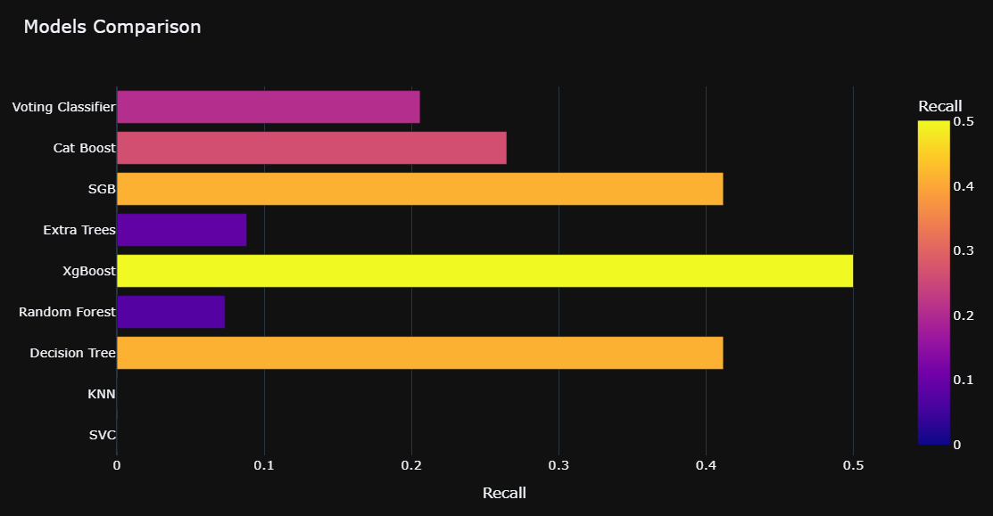
Results - Recall
Among all data, how many of positive cases that model can predict.
TP/TP+FN

Slide 13
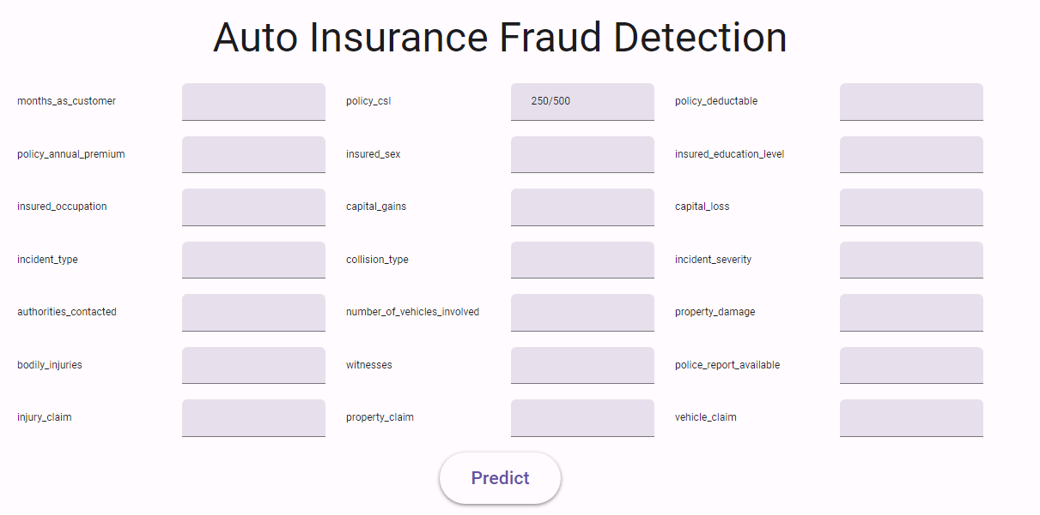
Model Deployment
Data Pipelines for Data Processing & model training using stacking technique
Save & Load Model using Joblib
Deployed to an Web App
https://BEIYGGRGWYJZN76O.anvil.app/GBQZBOBY6AUA25NAI55T4YHY
Future Scope: Improvement of UI, implementation of normalization technique in predicting single values

Slide 14
THANKS!

